Slide 1
House Price Prediction using Machine Learning
by Logeshwaran T
Guide
Dr. V. Auxilia Osvin Nancy, M.Tech, Ph.D.

Slide 2
Introduction
The real estate market is a complex and dynamic system influenced by numerous economic, social, and environmental factors. One of the most vital aspects of this industry is determining the price of residential properties. House price prediction has become a focal point of interest for various stakeholders, including buyers, sellers, real estate agents, investors, and policy makers. Accurate price estimation can aid in better financial planning, investment decisions, taxation, and even the formulation of housing policies.
In recent years, the traditional process of house valuation—often carried out by expert appraisers and real estate professionals—has faced scrutiny for being subjective, time-consuming, and sometimes inconsistent. This has led to the adoption of automated models powered by data science and machine learning to bring about a paradigm shift in how properties are valued.

Slide 3
Literature Survey
More recent literature has shifted toward data-driven approaches using machine learning (ML) and artificial intelligence (AI). For instance, Kumar and Paul (2019) applied linear regression and random forest techniques to predict housing prices and found that random forests outperformed traditional methods in accuracy and stability. Similarly, Li et al. (2021) employed Gradient Boosting Machines (GBM) and found significant improvements in performance due to the model's ability to handle feature interactions and nonlinearity.
Deep learning techniques, such as Artificial Neural Networks (ANNs) and Convolutional Neural Networks (CNNs), have also been explored. A 2020 study by Zhang et al. used ANN to predict housing prices and demonstrated its ability to generalize well when trained on large datasets. CNNs have even been applied to satellite images and street views to incorporate visual cues in price prediction.

Slide 4
Literature Survey
Another research trend involves integrating geospatial analysis and GIS (Geographic Information Systems) data to account for locational impact. These studies incorporate map-based data, proximity to amenities, and neighborhood characteristics, significantly improving prediction models. A notable contribution in this domain is the use of ensemble methods such as XGBoost and LightGBM, which have consistently outperformed standalone models due to their robustness against overfitting and superior handling of diverse feature sets.

Slide 5
Objectives
Accurate house price prediction is a critical component of real estate decision-making for buyers, sellers, investors, and policymakers. This study presents a data-driven approach to predicting house prices using machine learning techniques. By leveraging a combination of location-based features, property attributes (such as square footage, number of bedrooms and bathrooms, and year built), and economic indicators, we develop predictive models to estimate housing prices.
Several algorithms, including Linear Regression, Random Forest, and Gradient Boosting, are evaluated for performance. The results indicate that ensemble methods, particularly Gradient Boosting, provide the most accurate predictions with minimal error margins. This model can serve as a valuable tool for stakeholders in the housing market, enhancing transparency and aiding in data-informed decision-making.

Slide 6
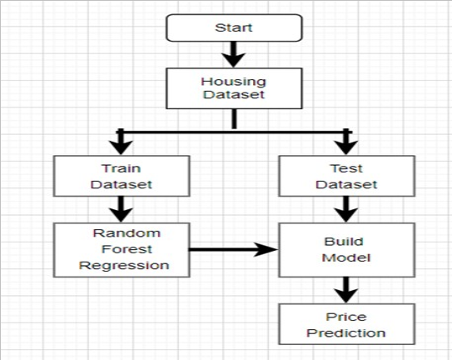
System Architecture

Slide 7
Methodology
The methodology for house price prediction involves a structured approach that begins with data collection from reliable sources such as real estate listings and government databases. The data typically includes features like location, area, number of rooms, age of the property, and amenities. After preprocessing to handle missing values, outliers, and categorical variables, exploratory data analysis (EDA) is conducted to understand feature relationships. Feature selection techniques are then used to identify the most relevant predictors. Various machine learning algorithms—such as linear regression, decision trees, random forest, and gradient boosting—are applied and evaluated based on performance metrics like mean squared error (MSE) and R-squared. The best-performing model is selected, fine-tuned using hyperparameter optimization, and validated using cross-validation. Finally, the model is deployed to predict house prices for new or unseen data, providing a useful tool for buyers, sellers, and real estate professionals.

Slide 8
Implementation
The implementation of a House Price Prediction system involves the integration of various software components, data science techniques, and machine learning models into a unified application that delivers accurate property price estimates. The process begins with data collection, where historical house sale records are gathered from sources such as government property registries, real estate platforms, or open datasets like the Kaggle House Prices dataset. This data typically includes features such as number of rooms, floor area, number of bathrooms, lot size, property location, year of construction, and other neighborhood-related variables
After preprocessing, feature selection and engineering are performed to identify the most influential factors affecting house prices. New features such as property age or proximity to city centers may be created to improve model performance. Once the data is prepared, it is split into training and testing sets. The training set is used to build machine learning models such as Linear Regression, Decision Trees, Random Forest, Gradient Boosting, or more advanced algorithms like XGBoost and LightGBM.

Slide 9
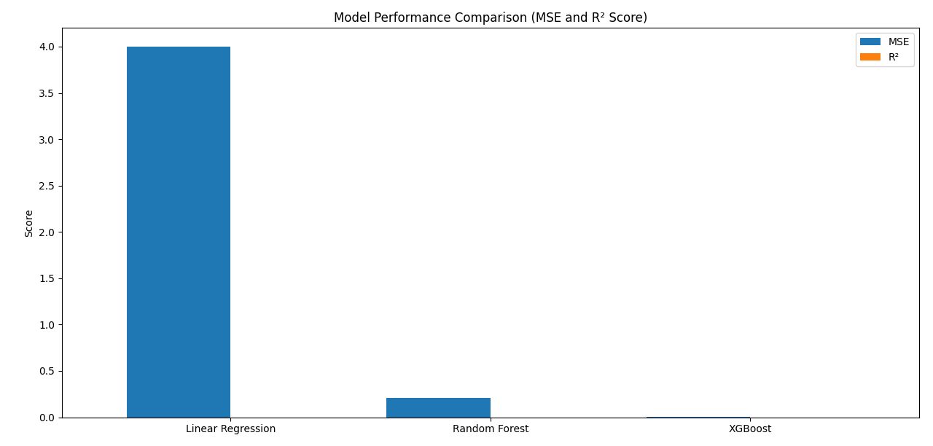
Results

Slide 10
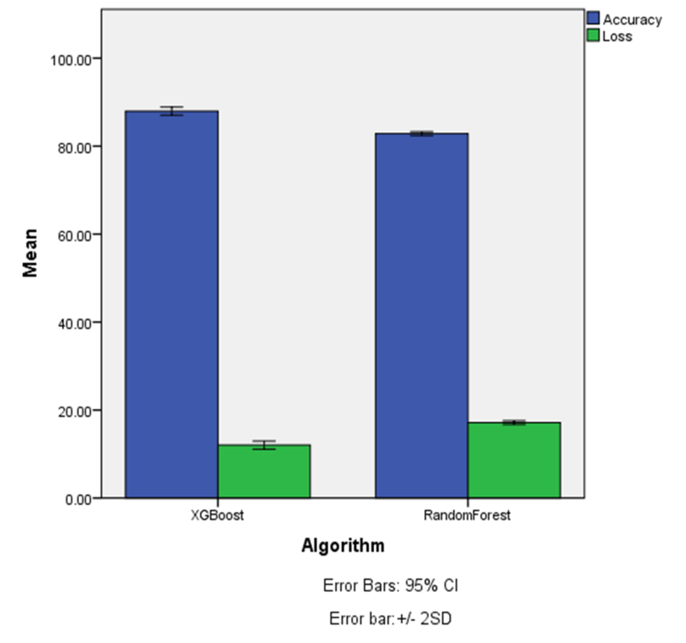
Results
Prediction Result

Slide 11
Comparison with existing work
Existing Mode | Proposed Mode
Linear Regression, Decision Trees, Random Forest | Extreme Gradient Boosting (XGBoost)
Derived features | Geospatial features,sentiment scores
Kaggle datasets | Customizing data sets
Single algorithm | Hybrid ensemble techniques
May overfit, especially decision trees | Regularization (L1 & L2) controls overfitting
Slower with large datasets (e.g., Random Forests) | Optimized with parallel computation and tree pruning

Slide 12
Conclusion and Future Work
Conclusion:
The implementation of the House Price Prediction system has demonstrated the powerful synergy between data science and real estate decision-making. Through a comprehensive process involving data collection, cleaning, preprocessing, feature engineering, model training, and deployment, the system successfully predicts housing prices based on a range of user-input variables such as property size, number of bedrooms and bathrooms, location, and year of construction. The use of advanced machine learning models such as Random Forest, Gradient Boosting, or XGBoost has enabled the system to capture complex patterns and relationships in the data that traditional statistical methods might overlook.
Future Work:
Another promising direction is the implementation of deep learning models like neural networks or hybrid models that combine structured and unstructured data. These models could be particularly effective in high-variance markets or in identifying nonlinear relationships among features. On the deployment side, the system can benefit from enhanced scalability and reliability through microservices architecture and cloud-native solutions, ensuring high availability and ease of updates.

Slide 13
Reference
Géron, A. (2019). Hands-On Machine Learning with Scikit-Learn, Keras, and TensorFlow (2nd ed.). Sebastopol: O’Reilly Media.
Raschka, S., & Mirjalili, V. (2020). Python Machine Learning (3rd ed.). Birmingham: Packt Publishing.
Ng, A. (2018). Machine Learning Yearning. Palo Alto: Deeplearning.ai.
Provost, F., & Fawcett, T. (2013). Data Science for Business. Sebastopol: O’Reilly Media.

Slide 14
THANK YOU

